Slide 1
STRATEGIC PLANNING
Canadian Association of Movers
2017 Annual Conference
Christine Sayegh-Filgiano
Senior Vice-President, Strategy & Operations
Office, North America
Ivanhoé Cambridge
Notes:
CIBC Square: $2B project; 2.9 M sq.ft.; 81 Bay street 49 floors, 1.5M sq.ft. Delivering in 2020
This project is a great example of change in cities today. It is being built right next to Union Station on what used to be the “wrong side” of Front street, the south side.
Now, that whole sector has been redeveloped with condos, office towers and hotels. People want to live walking distance from their work or from good public transport. We’re seeing a change in car ownership and usage which is influencing the number of parking spaces we’re incorporating in a our buildings.
Some of these changes are big and some are small. Some happen very slowly and gradually, like the evolution of a city, and sometimes it’s very difficult to even notice the change until it’s too late.

Slide 2
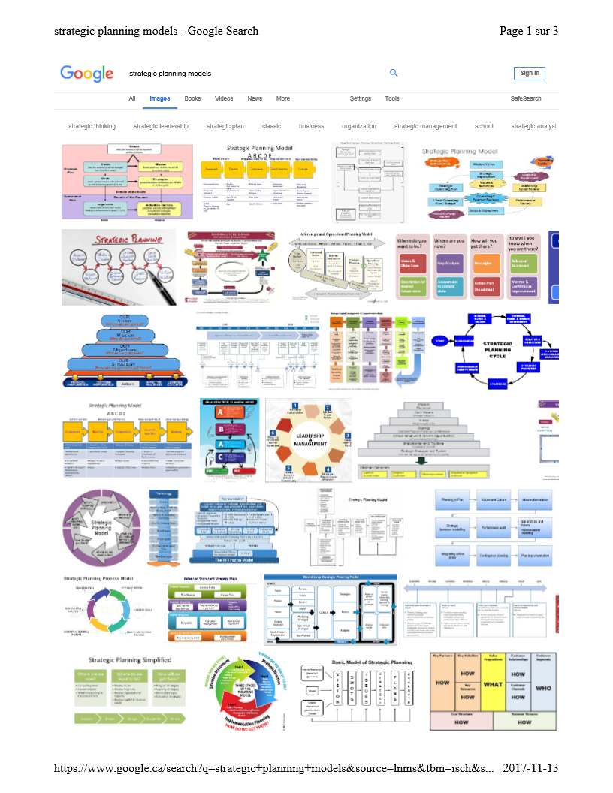
STRATEGIC
PLANNING
Notes:
So, what is strategic planning ??
Have I scared you yet ? This is just a small sample of all the different types of strategic planning models out there. What does this mean ? It means it doesn’t matter how you do this but it’s really important to do it.
Strategic planning is basically a thinking exercise that should be done once a year, about the big picture around you and also within your business.

Slide 3
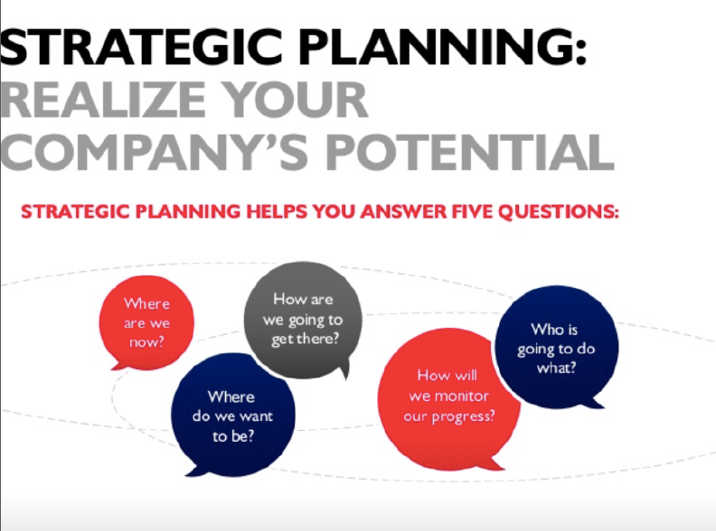
Where to begin…. ?
Source: BDC
Notes:
When I was preparing for this presentation, I was trying to find the best way to discuss this topic in such a short period of time.
We could spend the whole day just talking about Strategic planning.
So I went on the internet, which is often my go to place for brainstorming and I found this great slide on the website of the BDC (Business Development Bank)
I thought it provides a good big picture of what is strategic planning
Essentially, it’s a road map that helps you set your goals while understanding what’s happening inside your business and in the environment outside your business

Slide 4
Office – North America
Opportunities
We observe a changing investment market and leaning more towards demographic and social themes:
  Tenant demand for particular locations is driven by their search for talent
  Millennial labour pool mostly located in CBD area due to the desire to access mass transit, and need for amenities, and desire to live in urban area
  Strong demand from tenants for the CBD area as occupiers seek to maximize density, efficiencies and well being
Effect :
  Everywhere in North America we continue to see an inward migration of all office tenants including TAMI (Technology, Advertising, Media, and Information) type tenants to CBD from suburban markets.
  Across our nine US principal target markets, we are seeing very strong employment growth with unemployment rates falling below 5%, particularly in cities like
    Boston (4.2%);
    San Francisco (3.4%);
    Denver (4.1%) and;
    Seattle (4.5%).

Slide 5
Office – North America
Challenges
Foreign institutional capital
  Increasing presence in the North American CRE market but largely focused on Core type investments and primary markets (gateway markets).
  Price increased to levels that are making it increasingly difficult for us to transact at reasonable returns.
  Becoming an issue in certain markets in the United States where we want to grow the portfolio
CRE continues to be increasingly owned by institutional investors with long term needs for current yield.
  These investors are long-term holders and with time, this will limit the stock of properties that would normally come to market
  It will become increasingly difficult to assemble a portfolio of specifically targeted assets and locations
At the same time, moving slightly up the risk curve we begin to observe a decline in demand from North American investors, thereby making certain dispositions more challenging (bid is thinning and transactions taking longer to close)
A persistent low return environment that is partly the result of lower growth worldwide and highly stimulative monetary policies. This is an impediment to growth in private sector and consequently real estate space.

Slide 6

Strategic Orientations
I
Invest in deep and liquid markets that exhibit above average long term growth in fundamentals
II
Achieve critical mass in key cities
III
Leverage partnerships to source proprietary and off market opportunities
IV
Look for sizeable complex transactions requiring speed of execution
V
Maintain effective control of assets. Be an active manager.
$15.4 B
December 2016
$18.9 B
December 2020
2017-2020 Investment Plan
Notes:
One investment business benefiting from multiple operating platforms and business models
Investment management
Increase weight of US investments
Continue to recycle capital into targeted gateway markets
Asset Management
Leverage local know-how while remaining an active manager with leasing, capital and operating oversight
Achieve a consolidated view across the various platforms
Leverage technology to standardize reporting
Enable continuous benchmarking of operations and benefit from best practices

Slide 7
Strategic Orientations
Invest in deep and liquid markets that exhibit above average long term growth in fundamentals
Moving Industry Equivalent
Provide our services in dense markets that exhibit above average long term growth in fundamentals
Achieve critical mass in key cities
Moving Industry Equivalent
Achieve critical mass in key market segments
Particular neighbourhoods
Type of accounts, i.e. Gov., institutional (Hosp./ Univ.), corporate, residential
Leverage partnerships to source proprietary and off market opportunities
Moving Industry Equivalent
Leverage partnerships to improve or expand services offered, gain share of a targeted market or improve internal operations
$ X M
December 2018
$ Y M
December 2021
2018-2021 Sales Plan
Notes:
One investment business benefiting from multiple operating platforms and business models
Investment management
Increase weight of US investments
Continue to recycle capital into targeted gateway markets
Asset Management
Leverage local know-how while remaining an active manager with leasing, capital and operating oversight
Achieve a consolidated view across the various platforms
Leverage technology to standardize reporting
Enable continuous benchmarking of operations and benefit from best practices

Slide 8

Financial Overview
EBITDA = Earnings Before
Interest, Taxes, Depreciation and Amortization
EBITDA Margin = From every dollar of sales, how much is left to service debt, pay taxes, replace depleted capital, finance growth and pay a return to shareholders.
Operating profitability as a % of total revenue.
Notes:
Break down revenues by segment so you can track growth by its source
EBITDA is not a measure of cashflow nor profitability so you have to be careful how you use it.
But I like it because it separates operating profitability from all the noise that can blur the picture for a business manager. Noise to me, as a business operator includes financing costs, taxes and the various accounting methods used to depreciate or amortize assets. When I’m working on a strategic plan, I want to see purely and simply how the business itself, in its purest form, is doing, without the noise of leverage, tax schemes and accounting treatments.

Slide 9
Financial Overview
Revenues | 100 | 110 | 100
Operating Expenses | (50) | (50) | (40)
EBITDA | 50 | 60 | 60
EBITDA MARGIN | 50% | 55% | 60%
EBITDA = Earnings Before
Interest, Taxes, Depreciation and Amortization
EBITDA Margin = From every dollar of sales, how much is left to service debt, pay taxes, replace depleted capital, finance growth and pay a return to shareholders.
Operating profitability as a % of total revenue.
Notes:
Break down revenues by segment so you can track growth by its source
EBITDA is not a measure of cashflow nor profitability so you have to be careful how you use it.
But I like it because it separates operating profitability from all the noise that can blur the picture for a business manager. Noise to me, as a business operator includes financing costs, taxes and the various accounting methods used to depreciate or amortize assets. When I’m working on a strategic plan, I want to see purely and simply how the business itself, in its purest form, is doing, without the noise of leverage, tax schemes and accounting treatments.

Slide 10



Understanding your risks is key
BUSINESS RISK
OPERATIONNAL RISK
MODEL
OF RISKS
FINANCIAL RISK
Strategic
Legal
Compliance
Reputation
Disasters
Theft and
Fraud
Systems
Management
Markets
Process
Management
Human
Resources
Credit
Concentration and
Counterparty
Liquidity

Slide 11

Be purposeful
Set goals
Plan the execution
Follow through

Slide 12

Questions

