Slide 1
How to make the MOST out of everything you
do online
Maximizing your Social ROI

Slide 2
3 Main Things
Video Marketing:
The power of ENGAGEMENT-based videos
2) Pre-Qualifying your prospects with Facebook ads
3) The Power of Referrals

Slide 3
Purpose Based Branding

Slide 4
Purpose-Based Branding
Email open rates suck
The click through rate is even worse
But people watch videos…so welcome to the new age of advertising!

Slide 5
Purpose-Based Branding
Use your videos as part of a lead generation system
There are a few steps involved, but it’s not complicated
Hardest part: getting used to shooting video!

Slide 6
Purpose-Based Branding Flow

Slide 7
Live videos
These should be:
Helpful
Long form (6-10 minutes)
Start with introducing yourself
Then the topic
Then a teachable moment with a story and/or metaphor thrown in
End with a simple call to action – or none. Do NOT sell!

Slide 8
Live videos
Challenge is what do you say?
Helpful hints:
Answerthepublic.com
Google!
Questions you get asked on a regular basis!

Slide 9
Live videos
Let’s start building your LIVE video topic list!
Come up with the top 3 questions/problems people have
What STORY or METAPHOR can you relate the topic to?
Your call to action is simple: please share.

Slide 10
Offer Videos
Next, let’s talk about your OFFERS
What do people need MOST from you?
What can you OFFER to them?
Examples:
Get a quote
Talk to an agent
Book an appointment

Slide 11
Offer Videos
Offer video details:
Should be less than a minute long
Acknowledge that you are retargeting them so they know why they’re seeing the video
Have a STRONG offer
Have a CLEAR call to action

Slide 12
Pre-Qualifying Prospects with Ads

Slide 13
Building the perfect ad
Pre-framing: identifying the PERFECT buyer right in the ad itself
Generates fewer but more qualified leads

Slide 14
Building the perfect ad
Step 1:
Who is your best buyer?

Slide 15
Building the perfect ad
Step 2:
What do they truly value?

Slide 16
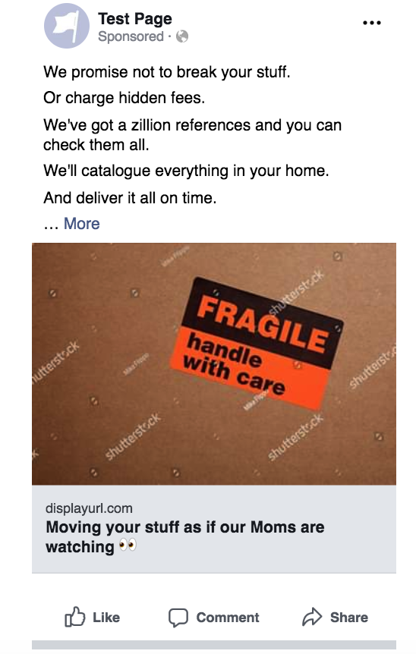
Building the perfect ad
Step 3:
Write long-form ads

Slide 17
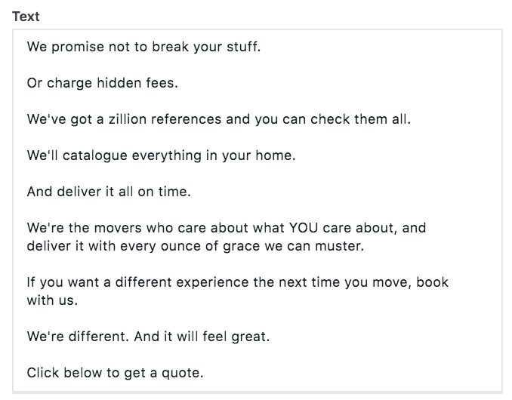

Slide 18
Building the perfect ad
Step 4: As custom questions on your ad
When do you want to move?
Do you have any special instructions or needs?
Or any other question that QUALIFIES a buyer

Slide 19
The Power of Referrals

Slide 20
Typical reviews
“They moved my stuff and didn’t break anything. It all arrived – like, all of it.”
“They showed up on time.”
“They answered my calls.”
“They didn’t drag mud through my house.”

Slide 21
NOT ENOUGH!

Slide 23
Opportunity #1: Before the Move
Objective: REMOVE a point of pain
Send moving boxes 1 week ahead of the move
Include tape, markers, pizza vouchers
Think of what YOU’D need right before you move

Slide 24
Opportunity #2: After the Move
Objective: REMOVE a point of pain
Send a cleaning service for their home or car
Do this 1 week after the move
Send mobile car cleaning service
Send cleaners or contractors to help patch up any dings or scratches

Slide 25
Opportunity #3: Never Stop
Objective: Stay top of mind
Send moments of “surprise and delight”
Send quarterly “lumpy” marketing drops
Make them OUTSIDE of typical holidays
Be consistent

Slide 26
And here’s what they’ll do

Slide 27
Here’s what you need to take away
1) Video is here to stay, but shooting engaging video is where it’s at – and then turn it into a lead generation machine
2) Pre-qualify your prospects with long-form ads
3) Focus on referrals – and let them share, share, share!

Slide 28
