Slide 1
Change: better embrace it Mario Lefebvre vice president, research, global real estate markets
Canadian Association of Movers
Montreal, Quebec
November 20, 2017

Slide 2
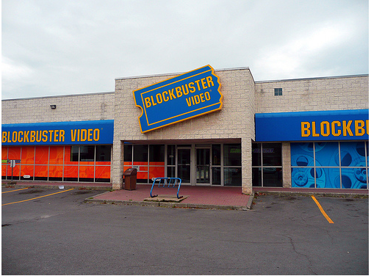
OBSOLETE FORMAT

Slide 3
BOOKS… WHAT BOOKS?

Slide 4
WHO BUYS A cD NOWADAYS?

Slide 5
RETAILORS THAT “FORGOT” TO ADAPT

Slide 6
Who takes pictures with a camera now?

Slide 7
What does the future have in store…

Slide 8
Some trends monitored in the real estate industry
E-commerce;
Automation;
Aging of the population;
Millennials’ behavior;
Driverless cars;
Etc.

Slide 9
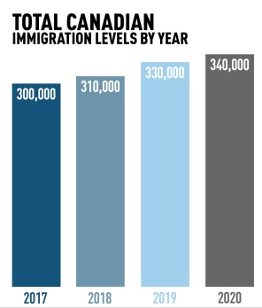
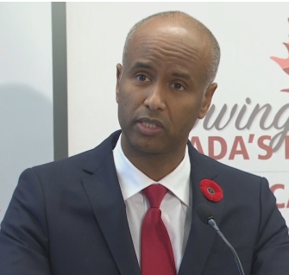
“Canada to admit nearly 1 million immigrants over next 3 years…Economic class will make up about 60% of newcomers” – CBC NEWS
“Five million Canadians are set to retire by 2035 and we have fewer people working to support seniors and retirees.”
Immigration Minister Ahmed Hussen
Source: CBC News

Slide 10
Population growth: thank you immigrants!
Source: Conference Board du Canada

Slide 11
demographic growth: a population turning grey
Source: Conference Board du Canada

Slide 12
Storage requirements of the elderly

Slide 13
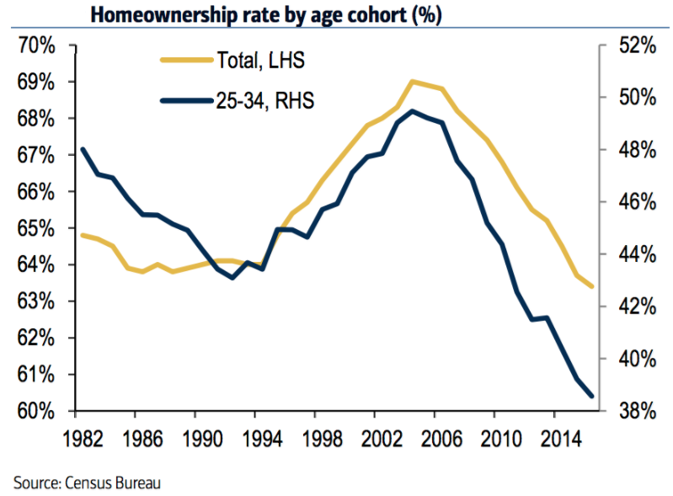
MilleNnials

Slide 14
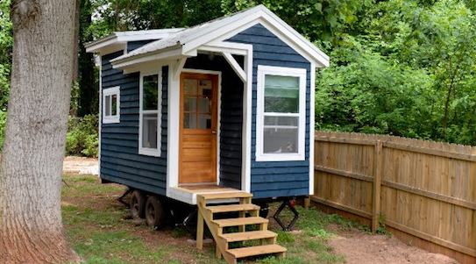
Storage requirement of Millennials
Financial Post, December 2013

Slide 15
Thank you

