Slide 1
CURING CANNABIS CONFUSION
A Guide Through The Haze
November 19th, 2018

Slide 2
TOPICS
RESEARCH
LEGISLATION
POLICY AUDIT
ACCOMODATION & IMPAIRMENT
EDUCATION

Slide 3
NEXT STEPS

Slide 4
This Photo by Unknown Author is licensed under CC BY

Slide 5
Wilson vs Transparent Glazing Systems

Slide 6
Work Place Policy
Duty to Report Procedure
Accommodation Policy for Medical Issues Based on Job Descriptions and Jobs Demands Analysis
Performance Issues and Documentation
Hierarchy of Disciplinary Responses

Slide 7
Work Place Education
Employee Education & Sign Off
Leadership Training
Difficult Conversation Training
Cultural Change & Discrimination

Slide 9
HRPA
2015

Slide 10
research

Slide 11
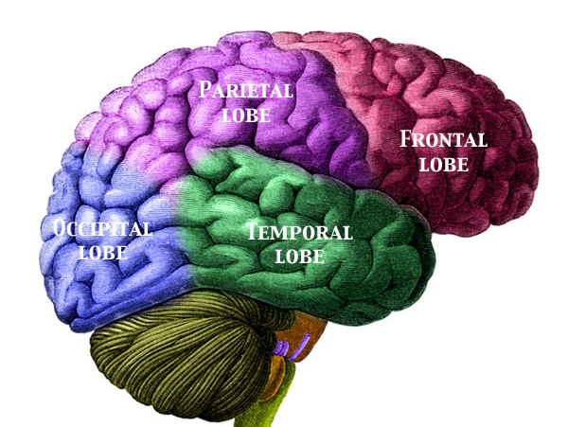
Dizziness, drowsiness, feeling faint Impaired memory Disturbances in attention concentration Disorientation, confusion, slowing of time
Suspiciousness, anxious, paranoia
Impairment of motor skills and mobility
Worsening of seizures
Hypersensitivity (dermatitis or hives)
Fast heartbeat Causes Nausea and vomiting
EFFECTS OF CANNABIS

Slide 12
Reduces Episodes of Seizures Improves Control Of Episodes of Anxiety Effective Treatment of chronic pain in adults Reduces Vomiting and Nausea for Chemotherapy Patients Increases Appetite and Decreases Weight Loss Positive Impact on Tourette's Symptoms Improves Mobility Aids In Focusing Attention
EFFECTS OF CANNABIS

Slide 13
BILL C-45 2001
Chronic Pain
Multiple Sclerosis
Tourette's
Chemotherapy Induced Nausea
HIV/AIDS Weight Loss
Anxiety
PST

Slide 14
Federal Government Providing 1.4 Million Dollars to 14 Research Projects 2017
Dr. Peter Smith Institute for Work & Health (Toronto) | Toking 9 to 5? Cannabis Consumption in the Canadian Workplace

Slide 15
SEPTEMBER 2, 2018
Health Canada Spending $100M on Cannabis Education over 6 years

Slide 16
LEGISLATION

Slide 17
THREE BILL C-45’s
2001 2004 2018
MRRA WESTRAY CANNABIS
RECREATIONAL
LEGALIZATION

Slide 18
Canadians continue to use cannabis at some of the highest rates in the world.
14. 5 MILLION CANADIANS USED CANNABIS 2015
21% of Youth & 30% of Young Adults

Slide 19
BLACK MARKET CANNABIS
400,000 KILOS Sold Annually By Black Market
Containing Contaminants: Pesticides, Other Drugs, Metals, Mould
This Photo by Unknown Author is licensed under CC BY

Slide 20
Tommy
Chong
3% to 5%
1960
Tommy Chong 30% to 80%
Black Market
Today
The High from 1 joint today
could be the equivalent of approximately 15 joints from 1970

Slide 21
The Government of Canada’s Goal for Legalizing, Regulating, and Restricting Access to Cannabis
Keep Cannabis out of the Hands of Canadian Youth
Prevent Organized Crime from Continuing to Profit from Cannabis

Slide 22
BILL C-45 2018 RECREATIONAL CANNIBUS
CANNIBUS OILS, VAPOURS, SMOKING

Slide 23
BILL C-45 2018 RECREATIONAL CANNIBUS
NO CANNIBUS EDIBLES
UNTIL 2019

Slide 24
Activity | Responsible
 | Federal | Provincial | Municipal
Possession limits ** | Yes | No | No
Trafficking | Yes | No | No
Advertisement & packaging ** | Yes | No | No
Impaired driving | Yes | Yes | No
Medical cannabis | Yes | No | No
Seed-to-sale tracking system | Yes | No | No
Production (cultivation and processing) | Yes | No | No
Age limit (federal minimum) ** | Yes | No | No
Public health | Yes | Yes | No
Education | Yes | Yes | Yes
Taxation | Yes | Yes | Yes
Home cultivation (growing plants at home) | Yes | No | No
Workplace safety | No | Yes | No
Distribution and wholesaling | No | Yes | No
Retail model | No | Yes | No
Retail location and rules | No | Yes | Yes
Regulatory compliance | Yes | Yes | No
Public consumption | No | Yes | Yes
Land use/zoning | No | Yes | Yes

Slide 25
FEDERAL
FEDERAL BILL C-45 and BILL C-46
ADULTS 18+
30 Grams Legally-Produced Cannabis
PRODUCTION
REGULATIONS
Licensed and Controlled Federally
DISTRIBUTION
& SALE
REGULATIONS
Enable Control Provincial Government
IMPAIRED DRIVING
New Provisions and Legal Framework
4 Plants Per Household

Slide 26
NATIONAL PARKS CONSUMPTION
APPROVED FOR: REGISTERED CAMPGROUNDS & BACKWOODS HIKING TRAILS
This Photo by Unknown Author is licensed under CC BY-SA

Slide 27
PROVINCES AND TERRITORIES RECREATIONAL CONSISTENT
CONSUMPTION APPROVED FOR:
Adults Only
Privately Owned Residences
May Be restricted by Lease, Landlord or Condo Bylaws.
POSSESSION 30 Grams for Adults Only.
RETAIL APPROVED FOR: Online or Approved Stores Away from Locations Where Minors Gather
BILL C-46 Zero Tolerance for Impaired Driving
VEHICLES APPROVED FOR: Transportation Only In Sealed Package.

Slide 28
PROVINCES AND TERRITORIES RECREATIONAL NOT CONSISTENT
LEGAL AGE
18
Alberta Quebec
19
Rest of
Canada
RETAIL
PRIVATIZED
Alberta Saskatchewan
Newfoundland Nunavut
GOVT. ONLY
Quebec, Maritime Provinces, NWT
Manitoba
COMBO
Ontario, BC, Newfoundland, Yukon
GROWING PLANTS IN PRIVATE RESIDENCES
No Plants
Quebec
Manitoba
FOUR PLANTS
Rest of Canada

Slide 29
RECREATIONAL CONSUMPTION- PROVINCIAL
BANNED
Where Minors Congregate
Use in Vehicles
ZERO PUBLIC CONSUMPTION
Manitoba, New Brunswick, Newfoundland, PEI, Saskatchewan, Yukon
PUBLIC CONSUMPTION ALLOWED Designated Smoking Areas in the Rest of Canada
EXCEPTION
Prohibited by the Municipality
BANNED
Vehicles & Where Minors Congregate
ZERO PUBLIC CONSUMPTION
Manitoba. New Brunswick, PEI, Newfoundland, Saskatchewan, Yukon
SOME PUBLIC CONSUMPTION:
Designated Smoking Areas in the Rest of Canada
EXCEPTION
Where Prohibited by Municipality

Slide 30
FEDERAL
MUNICIPALITIES RECREATIONAL
ZONING
Can Opt Out ?
LICENSING
Retail varies as some provinces are private, some govt. run and some both.
CONSUMPTION
Varies from zero tolerance to acceptable in smoking areas.
SPECIAL EVENTS
From Zero Tolerance to Special Permit Required.
If Opting In: not near areas where minors congregated. Distances vary.
Producers and Distributors must have federal and/or provincial and municipal.

Slide 31
Policy audit

Slide 32
Occupational Health & Safety
Labour Code
Human Rights
Local Bylaws
Criminal Code
Employer Legal Obligations and Responsibilities

Slide 33
CCOHS: EMPLOYERS are responsible for ensuring that employees are protected from others who may be under the influence.
HUMAN RIGHTS: Addictions or Disability Must accommodate employee to the point of undue hardship
CCOHS: EMPLOYEES are responsible for taking action to protect themselves or others from risk.
Governance

Slide 34
EMPLOYER
“Employers can set organizational policies about the physical presence of cannabis products in the workplace … while it may be legal to carry a small amount in public, the employer can determine if its presence is permitted at the workplace (similar to alcohol on the premises), regardless of intent of consumption.”
WORKPLACE STRATEGIES: RISK OF IMPAIRMENT FROM CANNABIS CANADIAN CENTRE FOR OCCUPATIONAL HEALTH AND SAFETY 2017
Notes:
Purpose:
Illustrate the limitations of existing drug & alcohol policies

Slide 35
START HERE
Employer Responsibilities
SURVEY
WORK SITE
IDENTIFY
RISKS & HAZARDS
JOB DESCRIPTIONS & DEMANDS ANALYSIS
BREAK THE JOB INTO A SEQUENCE OF STEPS
STEPS
REVIEW

Slide 36
TEAM INPUT
This Photo by Unknown Author is licensed under CC BY

Slide 37
POLICY MUST HAVES
CONFIDENTIALITY
SUBSTANCES
WHAT & WHEN
USE VS ABUSE
SELF REPORTING STRUCTURE
ACCOMODATION
IMPAIRMENT DEFINITION
MEDICAL DRUG
USE
EMPLOYER

Slide 38
POLICY MUST HAVES
EMPLOYEE RESPONSIBILITIES
DUTY TO REPORT
HEIRARCHY OF DISCIPLINARY RESPONSES
CRISIS RESPONSE PLAN
POPULATION IMPACTED
SIGN OFF PROCEDURE
EMPLOYEE

Slide 39
INDEPENDANT CONTRACTORS & THE PUBLIC ON YOUR WORKSITE
Some Variation By Province
Complex Web of CCHOS Laws
Reasonable Care-Business, Worker, Public
Insurance Coverage & Report
EMPLOYER DUTY
Protect the Health, Safety and Welfare Of Employees and OTHER people who might be affected by their business.

Slide 40
BEST PRACTISES CONTACTOR & PUBLIC
Site Visitors Policy
Sign In, Review Relevant Safety Policies, Provide Safety Equipment if Needed, Educate Staff
Contractor Sign Off on Policy Statement
Must have in place or enforce an Alcohol and Drug Policy which meets or exceeds your Policy or place use your policy

Slide 41
IMPAIRMENT

Slide 42
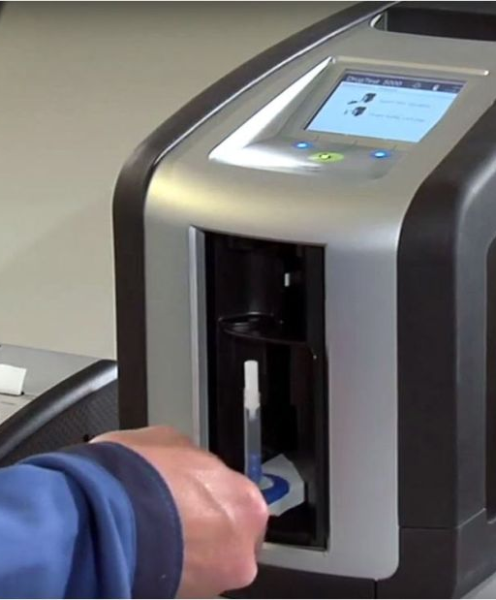
Drager Drug Test 5000
Punishments Increased
Justice Minister Jody Wilson-Raybould approved August 27
Cannabis and Cocaine
Present but impaired?
Not suited to cold temps
12% to 15% false positives
HR Charter and Courts

Slide 43
IMPAIRMENT
Canadian Human Rights Commission uses the following characteristics as they relate to changes in an employee’s attendance, performance or behavior:
Personality changes or erratic behavior (e.g. increased interpersonal conflicts; overreaction to criticism)
Appearance of impairment at work (e.g., odor of alcohol or drugs, glassy or red eyes, unsteady gait, slurring, poor coordination)
Working in an unsafe manner or involvement in an accident/incident
Failing a drug or alcohol test (if applicable)
Consistent lateness, absenteeism, or reduced productivity or quality of work

Slide 44
IMPAIRMENT COMMON CAUSES
Medications
Alcohol Intoxication
Stress
Undiagnosed Illness
Fatigue
Addiction
NOTE: Impairment is not universal, not all individuals respond the same to these sources

Slide 45
accommodation

Slide 46
Medical Cannabis Bill C-45 2001
“A common mistake that some employers make in accommodating medical marijuana is assuming using it will impair the employee’s ability to do the essential duties of their job.” Pariska Nikfarjam | Employment Lawyer

Slide 47
EMPLOYERS
HUMAN RIGHTS Addictions or Disability
Must Accommodate Employee to the Point of Undue Hardship

Slide 48
EMPLOYEES
DUTY TO REPORT
to the employer any thing or circumstance that is likely to be hazardous to the employees or any other person in the work place;

Slide 49
Medical use POLICY REVIEW
ACCOMMODATION
Work with Employee + Physician for forms of cannabis (Oil or Pills, CBD).
If Smoking:
Create specific, designated area away from entrances/ventilation intake and tobacco smoking area
Consult Local By-Laws -- Determine what’s Legal

Slide 50
Physical Demands Analysis
Break Job Into Steps
Lifting: How Much, How Often, How It Is Done
Positional: Standing, Walking, Sitting, Climbing
Possible Alternative Tasks
Templates Available

Slide 51
THE CRISIS
Call 911- if required AND/OR On-site First Responders
Notify Senior Management AND/OR Union Representative
Do not Allow Employee to Drive home. Do not Drive Home.
Incident Report. Include events preceding incident and list of actions/recommendation. File securely.
Muster Points, Fire, Flood, Tornado, H&S Board

Slide 52
HOW OFTEN TO REVIEW POLICY?

Slide 53
New Staff New Position New Legislation After Incidents Annually New Location Expansion

Slide 54
POLICY COMPLETED-SO WHAT?
IF A TREE FALLS IN THE FOREST AND NO ONE IS
THERE TO TWEET ABOUT IT…..
DID IT REALLY HAPPEN?

Slide 55
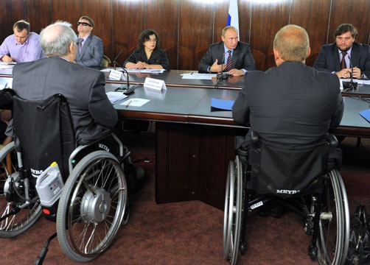
education

Slide 56
Work place concerns
Educate All Stakeholders On Policy Including New Hires

Slide 57
Employees Must…
EMPLOYEE RESPONSIBILITIES
KNOW
Policy. Know the procedure for dealing with impairment on the work site. Reporting incident, providing assistance.
Training on the all new policies and procedures as it pertains to them.
ATTEND

Slide 58
Work place concerns
Establish a Sign Off Procedure for All Stakeholders

Slide 59
WORKSHOP & TRAINING
Quizes
Review Job Descriptions Demands Analysis
Regular Updates
SIGN OFF PROCEDURES
Board
Union
Volunteers
Shareholders
Contractors
ROLLOUT

Slide 60
LEADERSHIP

Slide 61
Work place concerns
Provide Physical Demands Analysis and Job Descriptions
Document Performance Issues

Slide 62
Work place concerns
Ensure Supervisors Administer Policy Fairly

Slide 63
The Difficult Conversation Training
Speak to employee in private area.
Ask another supervisor to be present as witness.
Remove stigma of substance use – focus on safety concerns and observations. Do not diagnose. Ask do not tell.
Discuss employee options so per policy such as Accommodation, Progressive Discipline
Provide EAP Information.
Arrange transportation for employee if required.
Prepare a record of conversation and results and have it signed by all parties.

Slide 64
Success Factors for Performance Conversations
Courage
Accountability
Goals
Clarity
Openness

Slide 65
EQUALITY NO STIGMAS No DISCRIMINATION DO ASK & DO TELL
CULTURE AND LEADERSHIP

Slide 66
HEALTHY EMPLOYEES
Obesity
Alcohol
Cannabis
Tobacco
Sedentary Lifestyle
Poor Eating Habits
Lack of Sleep
Stress Management

Slide 67
TOPICS COVERED
RESEARCH
LEGISLATION
POLICY AUDIT
ACCOMODATION
EDUCATION

Slide 68
Notes:
Use a show of hands to see what is keeping these people awake.
Query the audience to see what are some other concerns they have with the upcoming legislation.

Slide 69
EDUCATE

Slide 71
Our Research Resources
“Canada Legalizes Pot” Heather Douglas 2018
CCHOS Impairment in the Workplace Certificate Program
Health Canada “Health Effects of Cannabis Fact Sheet”
https://www.theglobeandmail.com/news/...online...legal-marijuana.../article37019186/
http://business.financialpost.com/commodities/a-brief-look-at-provincial-appro
https://en.wikipedia.org/wiki/Legality_of_cannabis_by_country
nes A Best Practise Guide” 2014

Slide 72
Our Research Resources
https://www.canada.ca/en.html
https://www2.gov.bc.ca
www.gov.yk.ca
https://www.alberta.ca/
www.gov.nt.ca/
https://www.saskatchewan.ca/
https://www.gov.nu.ca/
https://www.gov.mb.ca/
https://www.ontario.ca/page/government
www.gouv.qc.ca/EN/Pages/accueil.aspx
“Canadian Model for Providing a Safe Workplace: Alcohol and Drug Guidelines A Best Practise Guide” 2014

Slide 73
Our Research Resources
Human Resources Professional Association “Clearing the Haze-The Impacts of Marijuana in the Workplace”
Canadian Federation of Apartment Associations : “Submission to Health Canada, The Department of Public Safety and the Attorney General of Canada” 2017
Impaired at work. A guide to accommodating substance dependence - Canadian Human Rights Commission
Information for Health Care Practitioners - Medical Use of Cannabis - Health Canada
Is your Drug and Alcohol Policy Up to Date - Workplace Safety North
Problematic Substance Use that Impacts the Workplace – A Step-by-Step Guide & Toolkit to Addressing it in Your Business/Organization - Atlantic Canada Council on Addiction

Slide 74
Our Research Resources
Human Resources Professional Association “Clearing the Haze-The Impacts of Marijuana in the Workplace”
Canadian Federation of Apartment Associations : “Submission to Health Canada, The Department of Public Safety and the Attorney General of Canada” 2017
Impaired at work. A guide to accommodating substance dependence - Canadian Human Rights Commission
Information for Health Care Practitioners - Medical Use of Cannabis - Health Canada
Is your Drug and Alcohol Policy Up to Date - Workplace Safety North
Problematic Substance Use that Impacts the Workplace – A Step-by-Step Guide & Toolkit to Addressing it in Your Business/Organization - Atlantic Canada Council on Addiction
“

Slide 75
Our Research Resources
“Workplace Strategies: Risk of Impairment from Cannabis” Canadian Center for Occupational Health and Safety
https://globalnews.ca/news/4123831/10m-marijuana-processing-plant-coming-to-east-london/
https://lcbocannabisupdates.com/
http://www.cbc.ca/news/canada/manitoba/retail-cannabis-stores-manitoba-1.4538478
http://www.cbc.ca/news/canada/saskatchewan/legalized-marijuana-regina-city-hall-1.4534209
https://www.edmonton.ca/city_government/cannabis.aspx
ace: Alcohol and Drug Guidelines A Best Practis

Slide 76
NEXT STEPS

Slide 77
Any Questions?
THANK YOU for the GIFT of Your TIME
Contact Us:
Western Master Business Mechanics Inc.
403-966-0957
westernbusinessmechanic@gmail.com
http://www.westernmechanics.com/

