Slide 1
Difficult Conversations – Planning for Family Business Successions

Slide 2

Notes:
Traffic circle on Ottawa Street in Kitchener Ontario – the new wave of intersections in Ontario

Slide 3
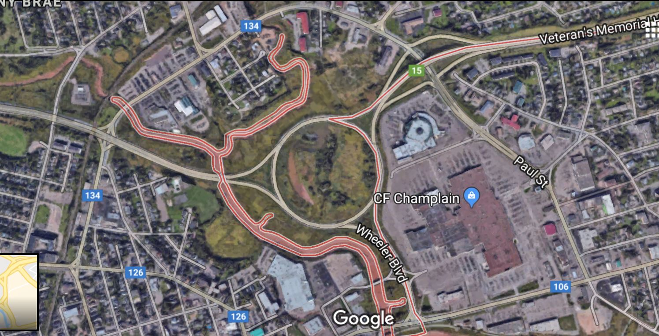
Notes:
Traffic circle in Moncton New Brunswick where I lived for 10 years… it’s 400m in diameter – circumference is 1.25Kms! That’s a mall beside it to give you context (CF Champlain) . Kids use it as a race track at night…

Slide 4

Swindon
Notes:
This is the famous Swindon Traffic circle – in place 60 years! It’s actually 7 traffic circles in one! I would argue that explaining to someone how to drive in the Swindon traffic circle is a close approximation for trying to navigate the process of working with family and planning for a family succession – it’s not simple! And always being changed!

Slide 5
Planning for Family Business Successions
About as simple as explaining to someone how to navigate the Swindon traffic circle!
Not simple but not impossible either!
Notes:
The operational demands of running a family business or other closely held enterprise can be all-consuming, but it’s vital that business leaders take the time needed to assess their organization’s business succession planning. The penalty for failing to get ahead of leadership or ownership changes can be significant, as the coming years may bring substantial transfers of wealth as businesses change hands and adopt new ownership structures. The long-term survival of a business, and the preservation of the wealth that has been built, will likely depend on getting ahead of those changes through strategic succession planning.
For private, owner-managed, or family-owned businesses, a solid succession plan can drive the growth of the business, reduce taxes, and set the stage for retirement. Family-run businesses may benefit further by focusing on preserving harmony within the family. Deloitte – Business Succession Planning

Slide 6

Working with Family
Notes:
Former Clemson head football coach Danny Ford talks about working his hemp farm with his son and grandson.
Working with family can be tough – I know full well. I grew up in the agricultural industry in rural Ontario – dad’s still farming, 73 years old. From the point at which I was “useful” (age 12) , I was working driving tractors , working land, cutting and baling hay and tending livestock. It was fun – a great life looking back (wasn’t always at the time).
Dad is not the easiest man to work with. As I got older and had more opinions (like 16+), I started to suggest different ways to do things. That usually didn’t go over well….. With time, we talked less and less and by the end of things, just before I went to university, we were pretty much not talking – he did things his way , I did things my way…. Neither of us liked it but things got done.
Looking back, it’s clear we both could have done things differently – and life in those days could have been a lot more enjoyable and smoother.
The joys of working with family!

Slide 7
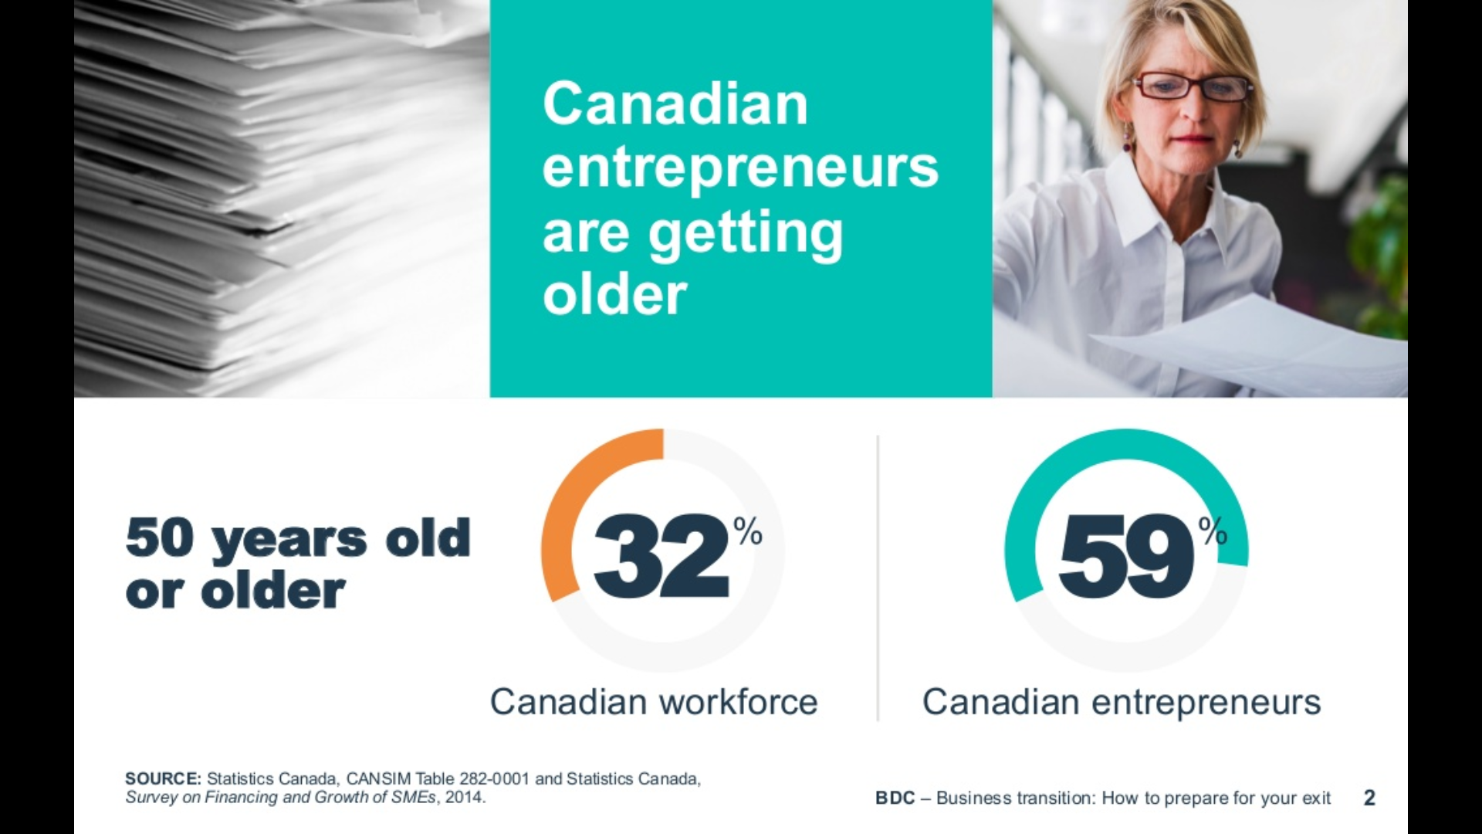
Business Development Bank of Canada Study
Notes:
BDC did a study and 59% of small business owners are north of 50 . Not really shocking.

Slide 8
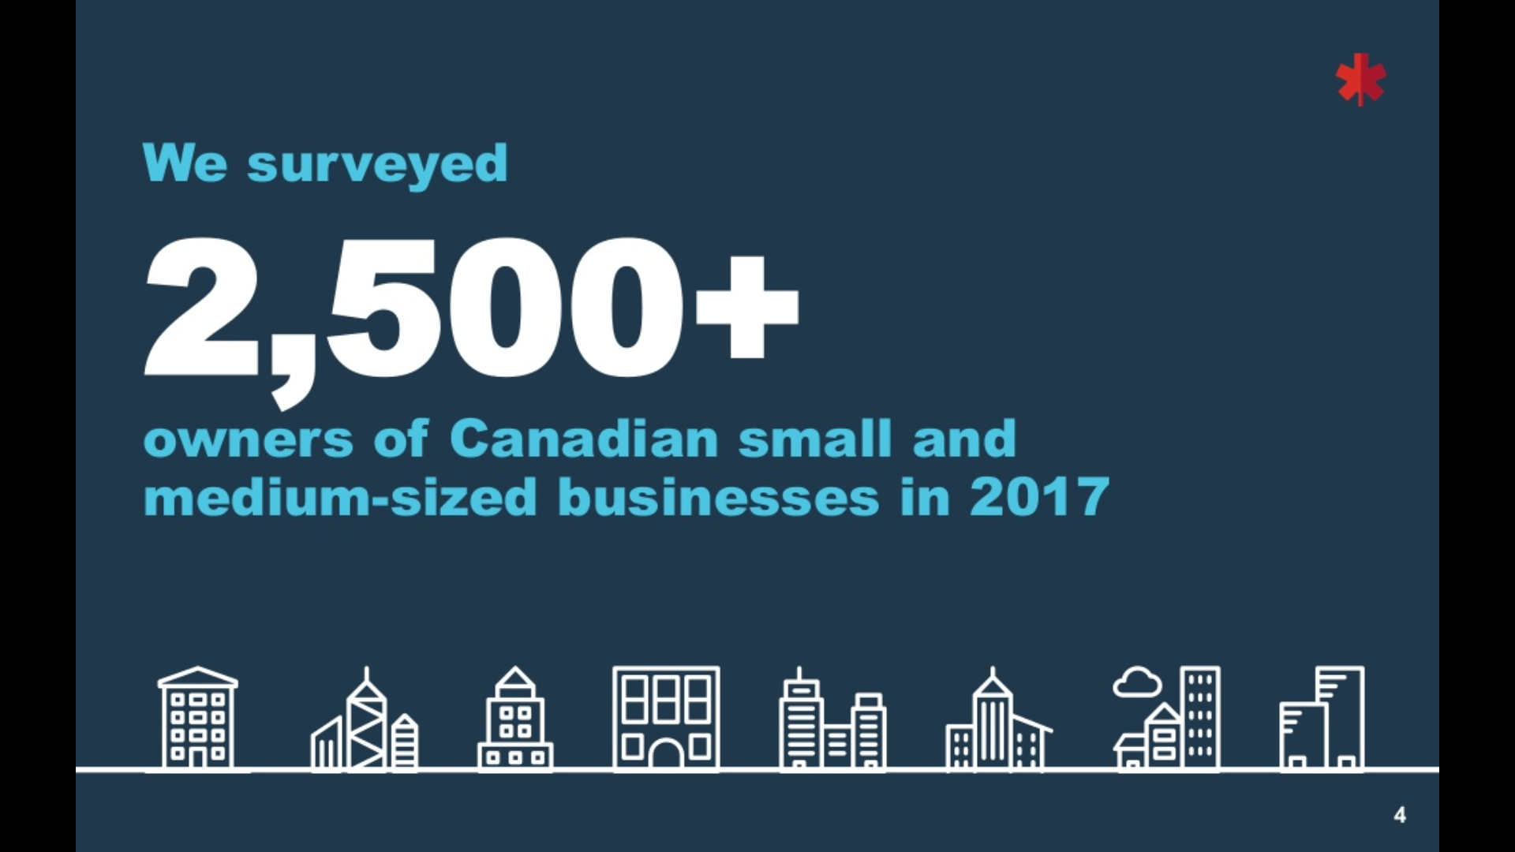

Slide 9
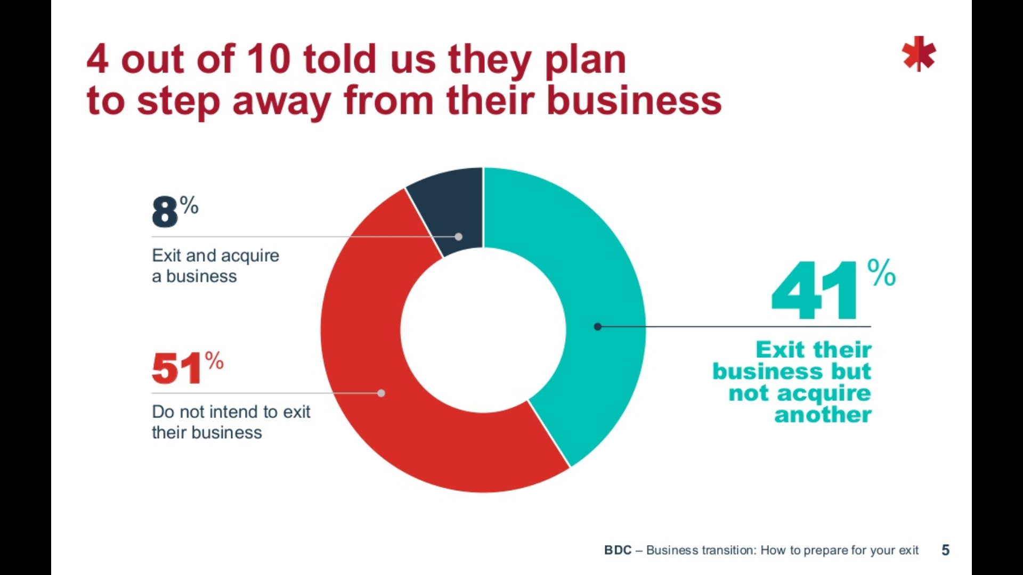
Notes:
41 percent of business owners want to “exit” their business.
Somewhat shocking is the 51% that don’t???? Are they planning on just working until death? Did they answer the survey this way because they don’t know how to get out of their business?

Slide 10
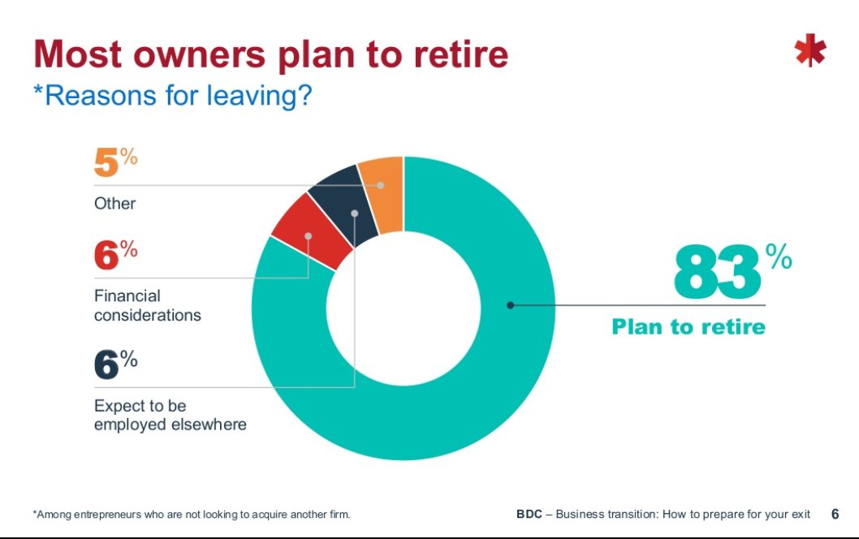
Notes:
Of those owners that want to exist the business, 83% said they wanted to retire.
So if they want to retire, they need someone (or group) to either take over their business and buy them out or they need to pass the reins to someone internal to the company – either employees or family.

Slide 11
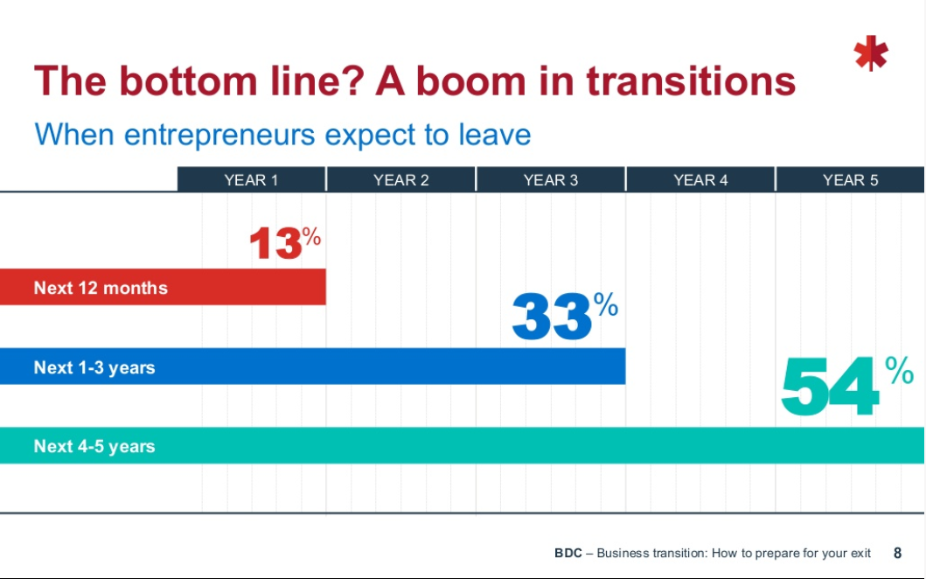
Notes:
So how many owners here today like to leave your business in the next 4-5 years?

Slide 12
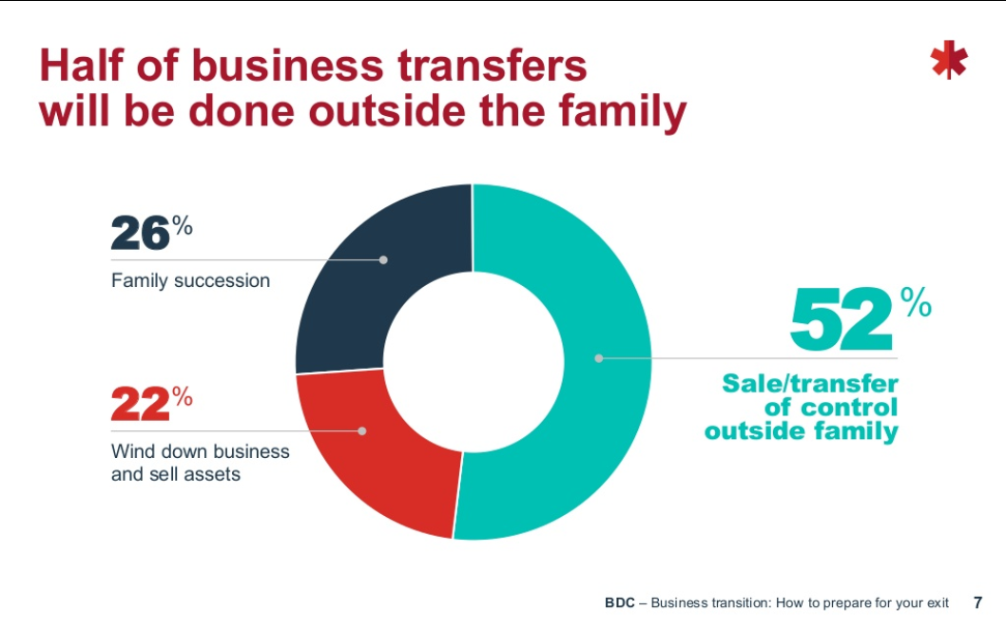
Notes:
Somewhat surprising but over half of business transfers are expected to be outside the family… wonder if that’s because the current owner thinks that would be easier? (sometimes it might be!)

Slide 13
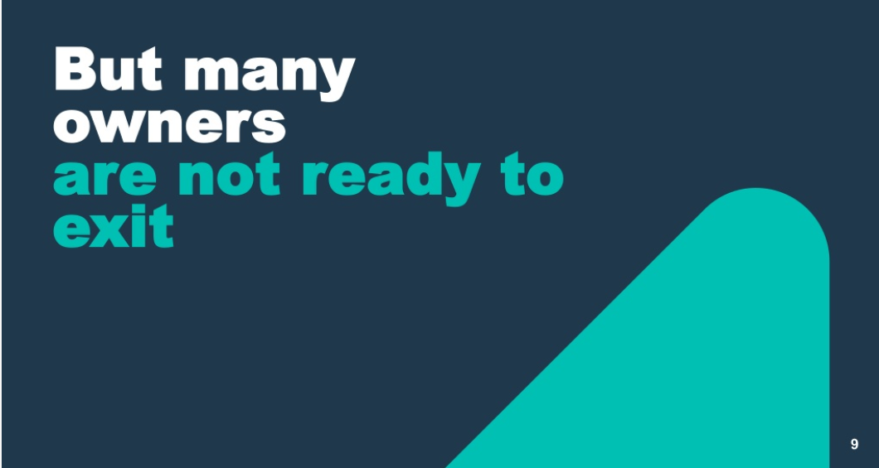

Slide 14

Notes:
When it comes to selling a business, good financial reporting is the difference between getting top dollar for a business and get just getting an offer. Prospective buyers want to see several years of history with full accounting to see trends.
Smart buyers of business know that a business typically sees a reduction in profitability in the first year after an ownership transition and will price this in .

Slide 15
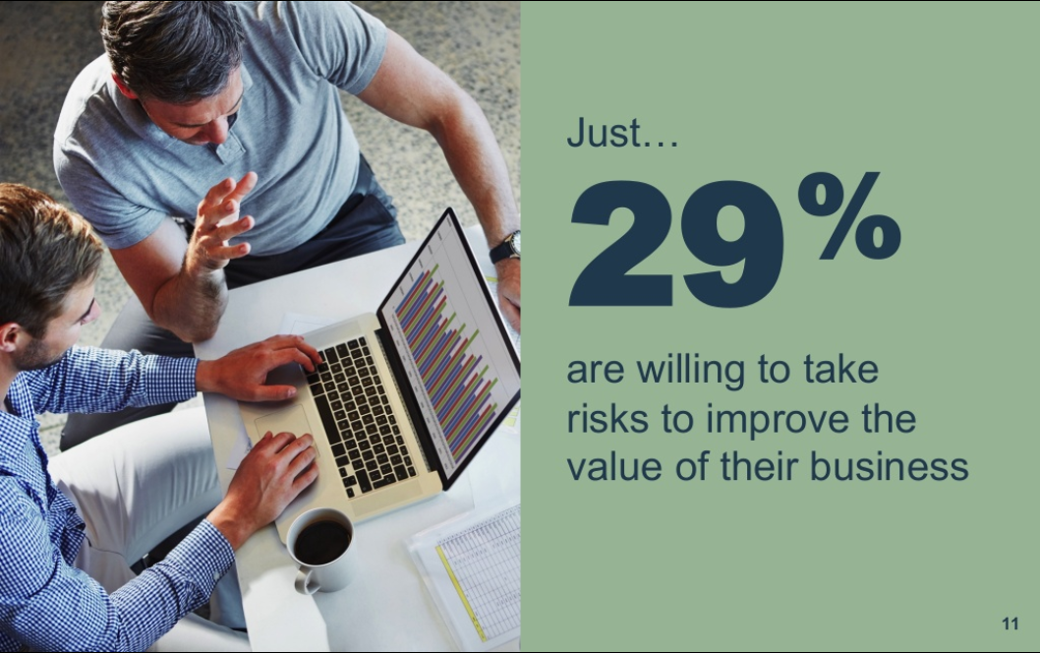
Only….
50%
Of family run businesses have a formal succession plan!
Notes:
Only 50% have a formal succession plan…. And I think that number is high! I think business owners have responded that they have an estate plan (if only in their mind) and plan for who will take the business over. But that is all they have – they truly do not have succession plans in place.

Slide 16


Slide 17
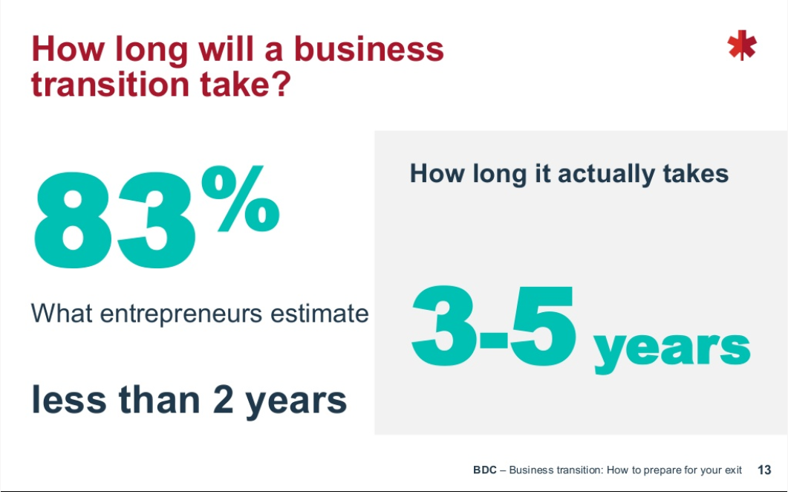
Notes:
Business owners think they can wrap up the transition process in under 2 years when in fact, statistically it takes closer to 3-5 years.

Slide 18
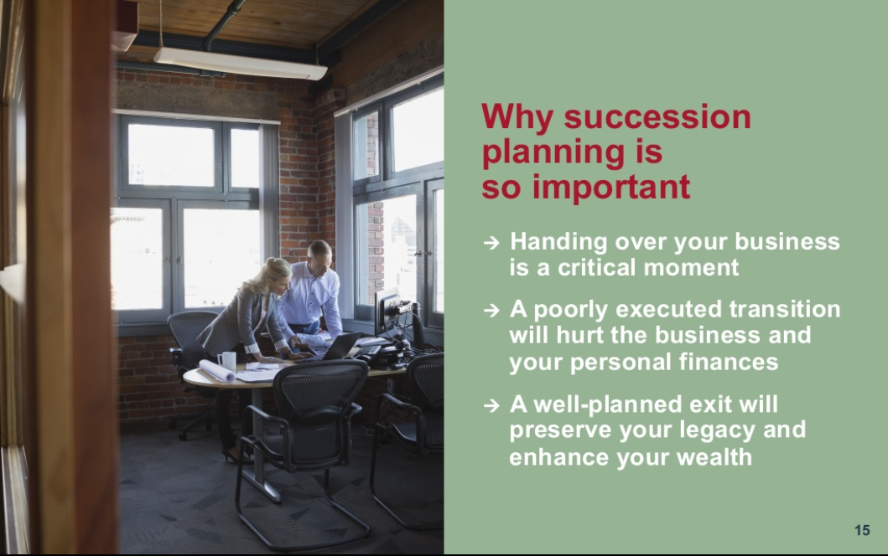
Notes:
Successsion planning is actually one of the more important planning processes in a business as it’s the process by which you extract the value which you’ve worked so hard to build over the years.. And if you are trying to transfer the business to family, you’ll often need to work to ensure its viability as you are taking your value “over time”… so the business needs to succeed!

Slide 19
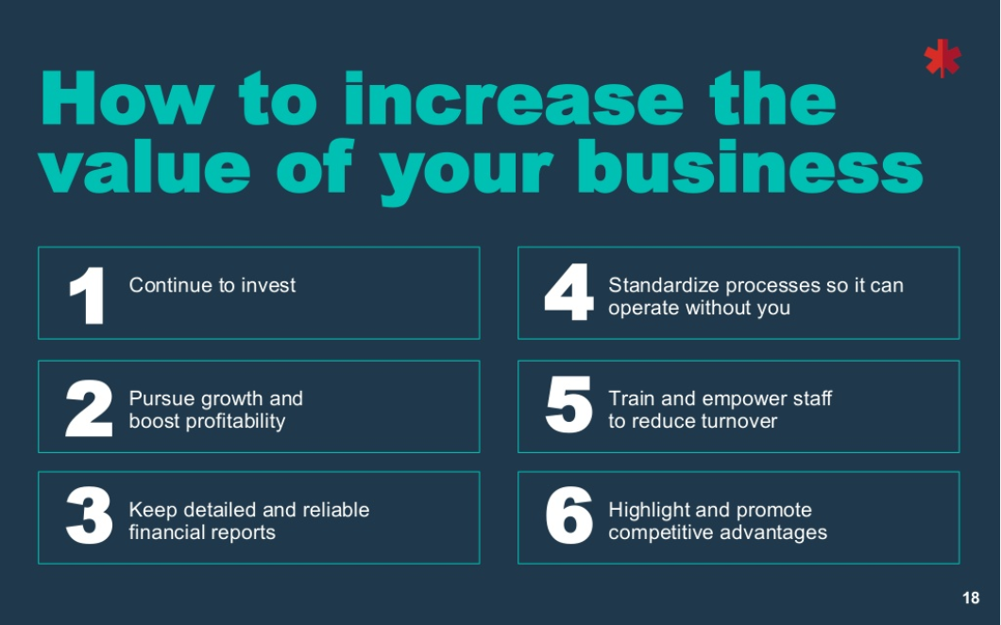
Notes:
I would argue that many family run private businesses lack the “standardized processes to operate without the owner” and that many small business owners fail to “train and empower their staff” – they consider themselves “the business” and fail to delegate enough to be able to take time off from the business – and find time to plan on behalf of the business .
I know the former transportation manager for a major international manufacturing conglomerate out of Chemical Valley (Sarnia) that said once “ the place should run the same whether you are there or not… if it doesn’t , you have not succeeded in your role!” .
I feel that this is certainly true!

Slide 20


Slide 21

Transition Success
Statistics say 1 in 3 businesses will survive to the next generation.
Of those, 1 in 4 will make it to the 3rd generation.
Succession Plans must address two primary issues: (1) Who should manage the business (2) Who should own it
They are sometimes NOT the same people.

Slide 22

Transition Options
Family continuing to own & manage.
Family own but outside management
Selling business to employees
Selling business to 3rd party
Liquidating.

Slide 23
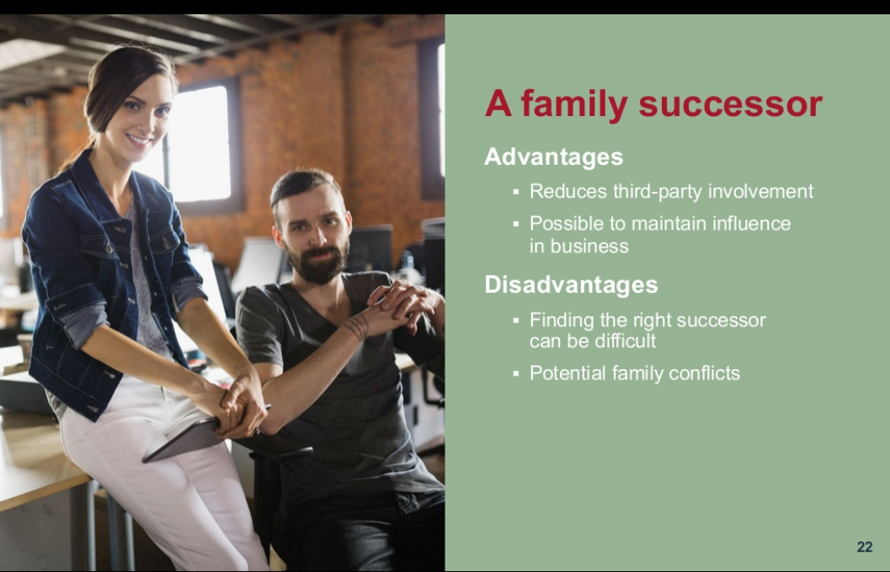

Slide 24
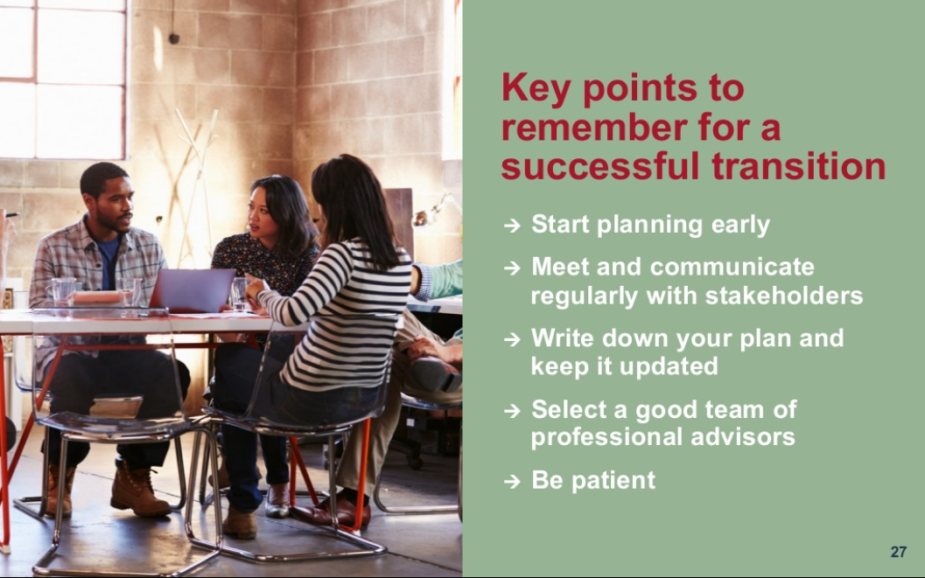

Slide 25
Succession planning — a starting point quiz
1. Have you defined your personal goals and a vision for the transfer of ownership and management of the company?
2. Do you have an identified successor in place?
3. If applicable, have you resolved the family issues that often accompany leadership and ownership decisions?
4. Does your plan include a strategy to reduce estate taxes?
5. Will there be sufficient liquidity to avoid the forced sale of the business?
Notes:
Succession planning — a starting point quiz
Compare your status quo to the questions below. If one or more “no” answers reveal deficiencies in your approach, know that you aren’t alone — and that it’s not too late.
1. Have you defined your personal goals and a vision for the transfer of ownership and management of the company?
2. Do you have an identified successor in place?
3. If applicable, have you resolved the family issues that often accompany leadership and ownership decisions?
4. Does your plan include a strategy to reduce estate taxes?
5. Will there be sufficient liquidity to avoid the forced sale of the business?

Slide 26
Succession planning - con’t
6. If succession will one day require the transfer of assets, have you executed a “buy-sell” agreement that details the process ahead of time?
7. Is there a detailed contingency plan in case the business owner dies or becomes unable to continue working sooner than anticipated? (is there insurance in place?)
8. Have you identified and considered alternative corporate structures or stock-transfer techniques that might help the company achieve its succession goals?
9. Have you determined whether you or anyone else will depend upon the business to meet retirement cash flow needs?
10. Have you recently had the business valued and analyzed in the same way potential buyers and competitors would?
Notes:
6. If succession will one day require the transfer of assets, have you executed a “buy-sell” agreement that details the process ahead of time?
7. Is there a detailed contingency plan in case the business owner dies or becomes unable to continue working sooner than anticipated?
8. Have you identified and considered alternative corporate structures or stock-transfer techniques that might help the company achieve its succession goals?
9. Have you determined whether you or anyone else will depend upon the business to meet retirement cash flow needs?
10. Have you recently had the business valued and analyzed in the same way potential buyers and competitors would?
A good plan takes time to develop and implement. This study is an introduction to the questions you’ll have to ask as you start down that road. In subsequent editions, separate guides will look more closely at several of the important topics.

Slide 27
Succession Planning
So if you answered “no” to more than one of those questions, we have some work to do!
But it’s not insurmountable!
Notes:
But its not insurmountable!

Slide 28
Translating a need into an imperative
• No one is sure exactly whom to call for help or how to start.
• Leaders worry about being fair to potential successors.
• Leaders struggle to acknowledge those personnel whom they want to retain on the management team but who aren’t in line for ownership.
• Leaders have difficulty discussing financial matters and personal goals with others.
• The owner may not wish to retire.
Notes:
Translating a need into an imperative
Even when everyone agrees succession planning is important and necessary, reasons to delay the process have a way of sprouting up.
• No one is sure exactly whom to call for help or how to start.
• Leaders worry about being fair to potential successors.
• Leaders struggle to acknowledge those personnel whom they want to retain on the management team but who aren’t in line for ownership.
• Leaders have difficulty discussing financial matters and personal goals with others.
• The owner may not wish to retire.

Slide 29
Translating a need into an imperative
• Leaders struggle to disconnect from the day-to-day urgencies to focus on long-term planning.
• Leaders are reluctant to commit to complicated strategies that may save taxes but don’t address their own non-tax goals and concerns.
• They don’t believe successors are ready to assume control, and so they feel nothing can be done.
• The entire process seems too daunting.
• Leaders perceive it is a cost that delivers no immediate benefit.
Notes:
Translating a need into an imperative
• Leaders struggle to disconnect from the day-to-day urgencies to focus on long-term planning.
• Leaders are reluctant to commit to complicated strategies that may save taxes but don’t address their own non-tax goals and concerns.
• They don’t believe successors are ready to assume control, and so they feel nothing can be done.
• The entire process seems too daunting.
• Leaders perceive it is a cost that delivers no immediate benefit.
These anxieties help explain why so few private businesses have an actionable succession plan in place. Few business owners simply ignore the issue, but many may focus too narrowly on individual elements of a succession plan without taking on the full range of important issues. The result can be false security followed by a poor outcome for everyone involved.
These potential blind spots in long-term planning can cost business owners and families through lost future value as well as a hit to their legacy. An inclusive, multidisciplinary approach to succession planning can dramatically increase the chance for desirable results.

Slide 30
Succession Planning
Aligning goals across time — and across roles
Taking the time to understand the factors that really drive a company’s continuity and growth can help owners and stakeholders create strategic priorities and develop a detailed action plan.
Notes:
It’s common for leaders to think of succession planning in terms of the organizational chart — which people will replace which people. But it’s just as important to think of an organization’s operating structure and how it may change over time. What are the functional activities that must happen today? How will they be different tomorrow as the business grows? Will your customer base, suppliers, or product mix experience significantly change? Only then can you turn to the question of which people will carry out those functions.

Slide 31
Communication with stakeholders
Biggest Threat to smooth transitions is lack of communication!
It doesn’t mean everyone will get what he or she wants.
Include all stakeholders in goal-setting process
Notes:
Communication with stakeholders
Lack of clear communication is one of the biggest threats to a smooth transition of a business from one generation to the next.
Once you have identified critical issues, it’s important for the company to articulate the owner’s personal goals and vision for the future of the business, while also considering the needs and concerns of other stakeholders. That doesn’t mean everyone will get what he or she wants. But by including the stakeholders in the goal-setting process, owners and other relevant decision makers can operate from a wider base of information. They can encourage all parties to feel a sense of ownership in the succession plan and strategic planning. And they can greatly improve the likelihood that it will play out as they intend

Slide 32
Strategic Planning
Key Managers and owners of the business should develop the plan.
Use internal resources and external consultants.
Make it a team effort!
Notes:
Who should lead strategic planning?
Select managers and owners of the business should assume responsibility for developing and executing the strategic plan. These individuals understand the business intimately. They recognize its potential and limitations. They can commit the resources required to implement plans, and they can initiate and monitor the steps that will drive implementation. They should oversee the formal analysis of the strategic planning data, reach the necessary conclusions, and commit the business to future courses of action.
This does not mean other internal resources or external consultants cannot or should not play a role in the strategic planning process. Indeed, both staff members and outsiders can offer invaluable perspectives in the development of a sustainable plan.

Slide 33
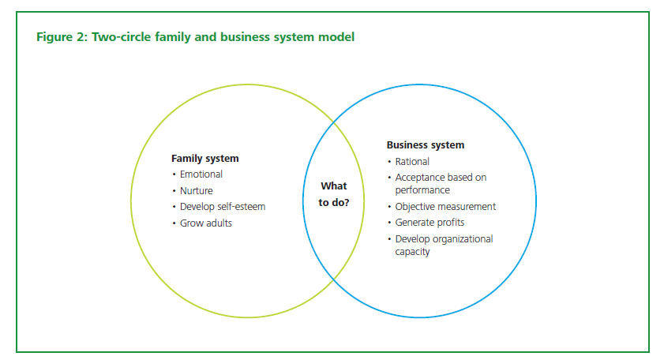
Corporate Governance
Notes:
Shared purpose? Or cross purposes?
Succession planning is an important consideration for all companies, but for family businesses, there is an added layer of complexity. Throughout the years, a family business serves two masters whose priorities aren’t always the same. And when it’s time to pass the reins, the interplay between business strategy and family dynamics holds the potential for real conflict. The fortunes of the company and the status of the family are both at stake.
Like every other aspect of business succession planning, the question of family dynamics and governance is best addressed over the long term. This is a process, not an event. Years before an actual change of leadership, the owners of a family business should consider making clear determinations about its stakeholders, its obligations, and who controls what. For many businesses, these are just decisions. For family businesses, they may prompt the creation of entirely new governance structures.
There’s more to this than avoiding trouble. A thoughtfully governed family business can be a boon for everyone involved — not only in terms of wealth creation, but also in promoting harmony, personal fulfillment, and shared purpose. It’s no accident some families build their professional lives so close to their personal lives. Good governance can help the business and the family prosper together.
Family business challenges
Left to themselves, business concerns and family concerns can interfere with one another. Even with a clear boundary in place, family businesses and their owners should consider most succession planning issues from both perspectives. When it isn’t clear which agenda is driving things, the decision-making process can become confused and inconsistent. Family relationships deteriorate, business success suffers, and the succession plan may be derailed.
Communication, or the lack of it, can be a significant issue for families in business. The family business is often the primary source of family income and future wealth, so every family member likely will be affected by the business operations and succession decisions — including the ones who have no formal employment or leadership role in the company. Since all family members may have or want some degree of interest in the direction of the company and expect to have a voice, the succession plan can take this into account.

Slide 34
Family Business
More challenging than most businesses to run
More dynamics to deal with
Notes:
One of the challenges for family business owners in succession planning is to deal effectively with a myriad of business and financial issues such as ownership transition, management development, retirement planning, tax planning, and strategic direction while managing the emotional condition of all of the stakeholders throughout the process — which may be the most difficult aspect of all.
There are tested strategies and methodologies that may help family business owners through this process. One of the more prominent of these strategies includes the implementation of formal family policies and governance structures. Enhanced understanding promotes empathy and trust, which leads to compromise and resolution. Communication is generally improved and the ability of the business to preserve shareholder value is sustained. At the center of communication and understanding is transparency. Family businesses can keep problems from taking root if everyone is informed and honest about goals and decisions.

Slide 35
Business Management
Family businesses should have an “outside” board (or number of ) advisors
The advisors will be objective and make recommendations in the best interest of shareholders and the company
The outside advisors should have the predominant say in whom should succeed the current owner as CEO
Notes:
Outside board of directors or board of advisors
Many owners of privately held businesses fail to take full advantage of the benefits formalized governance structures can provide. In particular, a business that doesn’t have a functioning board of directors or outside board of advisors may be missing out on a tremendous opportunity to improve management and profitability, especially during a period of transition.
An outside board, composed of individuals with years of business experience, can be a strategic asset by providing the business owner with valuable advice. These board members likely will make recommendations on what they believe represents the best interests of the shareholders and the company. Indeed, their relationship with the company imposes a fiduciary responsibility — a “duty of care” and “duty of loyalty” — to uphold those interests.
Outside directors and advisors can also help play an important, objective role in the implementation of a management succession plan. One area where a board has an impact on succession is in its role of identifying candidates to take over as CEO — and in working with the current CEO to carry out that process. Board members can help assist in identifying possible successors from the pool of candidates and serve as mentors for successor candidates. They may also advise on the broader talent plan and help with the implementation and monitoring of the management talent assessment and the management development plan. The board may provide oversight of the plan, determining that the process remains untainted and consistent.
Approaching succession with reliance on outside directors or advisors can also help defuse family conflicts. If the founder-owner is perceived to be the sole decision maker in succession matters, emotional ties and demands for personal loyalty can cloud determinations of skill, experience, and potential. When a board picks a successor, no one is left wondering which family member the board “loves more.”

Slide 36
Case Study – Family Feud
Robert is owner (62)
Nathan and Emily oldest two children, inexperienced but working in business. John , youngest child, doesn’t work in business.
Robert wants to retire but can’t as Emily and Nathan are not prepared yet to take over. Eventually leaves in 2 years.
Business loses key employees and salespeople, eventually sold for significantly less than it was worth when Robert retired
Notes:
CASE STUDIES
The following scenarios are based upon experience with actual family businesses. They are intended to illustrate the importance of goal setting, communication, and a holistic approach to succession planning.
Family feud
Robert is a closely held business owner in his early 60s. Two of his children, Nathan and Emily, are relatively inexperienced at working in the business, and a third child, John, does not work in the business at all. Robert wants to scale back involvement in the business so he and his wife can move away and enjoy their retirement years together.
With outside help, Robert builds an estate plan that includes family partnerships and trusts that hold insurance and company stock. The family’s perception is that the business succession plan is “complete.”
A year later, Robert is ready to retire, but cannot because the siblings are floundering in their executive development. Robert relies more on non-family employees, who are not in line for ownership, to get things done. Nathan and Emily resent this. Meanwhile, John feels the salaries, company cars, and other benefits Nathan and Emily draw from the company are coming at the expense of his inheritance.
When Robert finally does pull away, Nathan and Emily assert their leadership in the resulting vacuum despite their lack of preparedness. Several important executives and customers leave, sales fall off, and the top salespeople go to the competition. John wants Nathan and Emily demoted or fired to protect the value of the inheritance. Robert worries about the value of his stake as a source of retirement funding.
Months later, company operations continue to suffer. The children are no longer speaking with each other and holiday get-togethers are cancelled. John forces a sale of the business for cash, but the family receives only a fraction of the amount that financial advisors and attorneys projected years earlier in the estate plan. Taxes eat half of even that disappointing sum.
Nathan and Emily are not equipped to find similar high-level jobs elsewhere, and they struggle professionally. John blames Nathan and Emily for gutting his inheritance. Robert must revisit his post-retirement dreams. In the aftermath of the sale of the business, all the estate tax planning accomplished years before has been unraveled.

Slide 37
Case Study – Analysis
Robert had an estate plan but no succession plan! (they are not the same!) He likely should have started thinking about succession 5+ (or more!) years ago.
Robert did not assess his kids ability to run the business (could have encouraged outside employment before “coming home to the family business” or more training.)
Robert did not have any outside advisors on business governance and strategic planning.
Notes:
Analysis
Robert relied on specialists for sophisticated estate planning. Why did everything go wrong? In reality, estate planning is only one facet of succession planning. Robert made a plan for transferring enterprise value, but not one for continuing to generate or maintain that value. His approach to succession planning should have incorporated management talent assessment, compensation planning, stock transfer strategies, formal directorship roles for both family and non-family officers, corporate structuring, communication plans, and estate planning.

Slide 38
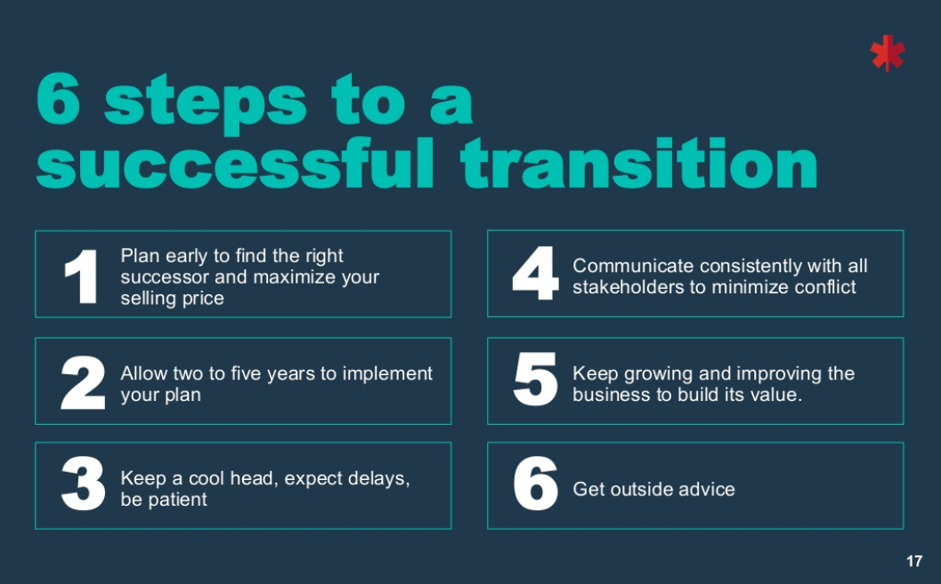

Slide 39
Summary
Key is always communication when it comes to family succession plans!
Plan sooner rather than later.
Find outside help – in the form of objective business advisors and professional (legal, insurance and accounting).
Questions?

Slide 40
Joval Group Family Business

