Slide 1
Canadian Association
of Movers
2018 Annual Conference

Slide 2
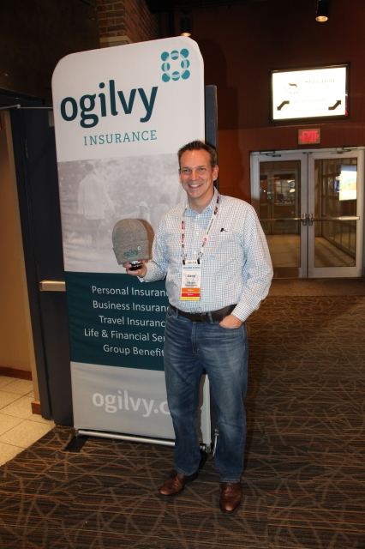
Canadian Association
of Movers
2018 Annual Conference

Slide 3
Canadian Association of Movers
2018 Annual Conference

Slide 4
Canadian Association of Movers
2018 Annual Conference

Slide 5
Canadian Association of Movers
2018 Annual Conference

Slide 6
Canadian Association of Movers
2018 Annual Conference

Slide 7
Canadian Association of Movers
2018 Annual Conference

Slide 8
Canadian Association of Movers
2018 Annual Conference

Slide 9
Canadian Association of Movers
2018 Annual Conference

Slide 10
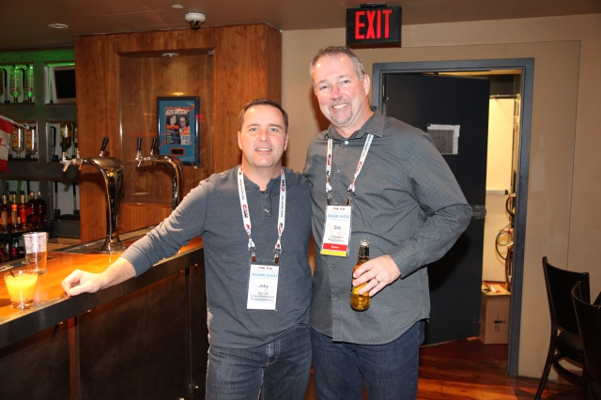
Canadian Association of Movers
2018 Annual Conference

Slide 11
Canadian Association of Movers
2018 Annual Conference

Slide 12
Canadian Association of Movers
2018 Annual Conference

Slide 13
Canadian Association of Movers
2018 Annual Conference

Slide 14
Canadian Association of Movers
2018 Annual Conference

Slide 15
Canadian Association of Movers
2018 Annual Conference

Slide 16
Canadian Association of Movers
2018 Annual Conference

Slide 17
Canadian Association of Movers
2018 Annual Conference

Slide 18
Canadian Association of Movers
2018 Annual Conference

Slide 19
Canadian Association of Movers
2018 Annual Conference

Slide 20
Canadian Association of Movers
2018 Annual Conference

Slide 21
Canadian Association of Movers
2018 Annual Conference

Slide 22
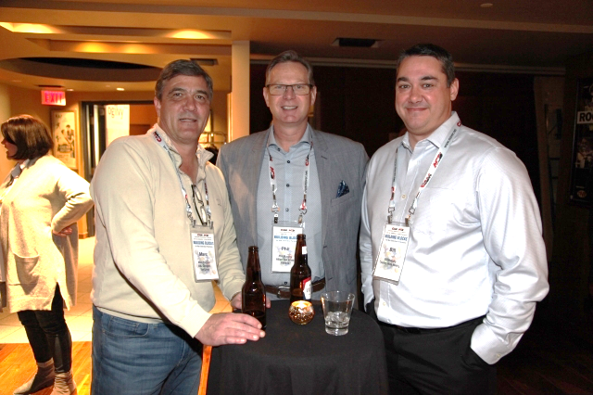
Canadian Association of Movers
2018 Annual Conference

Slide 23
Canadian Association of Movers
2018 Annual Conference

Slide 24
Canadian Association of Movers
2018 Annual Conference

Slide 25
Canadian Association of Movers
2018 Annual Conference

Slide 26
Canadian Association of Movers
2018 Annual Conference

Slide 27
Canadian Association of Movers
2018 Annual Conference

Slide 28
Canadian Association of Movers
2018 Annual Conference

Slide 29
Canadian Association of Movers
2018 Annual Conference

Slide 30
Canadian Association of Movers
2018 Annual Conference

Slide 31
Canadian Association of Movers
2018 Annual Conference

Slide 32
Canadian Association of Movers
2018 Annual Conference

Slide 33
Canadian Association of Movers
2018 Annual Conference

Slide 34
Canadian Association of Movers
2018 Annual Conference

Slide 35
Canadian Association of Movers
2018 Annual Conference

Slide 36
Canadian Association of Movers
2018 Annual Conference

Slide 37
Canadian Association of Movers
2018 Annual Conference

Slide 38
Canadian Association of Movers
2018 Annual Conference

Slide 39
Canadian Association of Movers
2018 Annual Conference

Slide 40
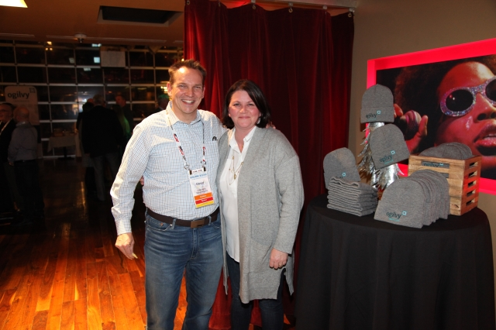
Canadian Association of Movers
2018 Annual Conference

Slide 41
Canadian Association of Movers
2018 Annual Conference

Slide 42
Canadian Association of Movers
2018 Annual Conference

Slide 43
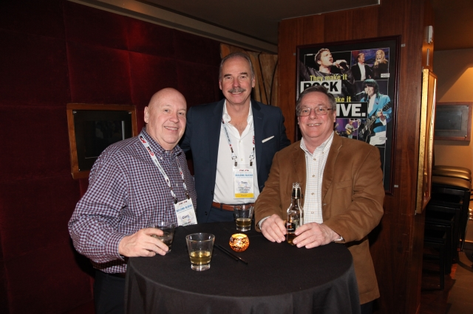
Canadian Association of Movers
2018 Annual Conference

Slide 44
Canadian Association of Movers
2018 Annual Conference

Slide 45
Canadian Association of Movers
2018 Annual Conference

Slide 46
Canadian Association of Movers
2018 Annual Conference

